Slide 1


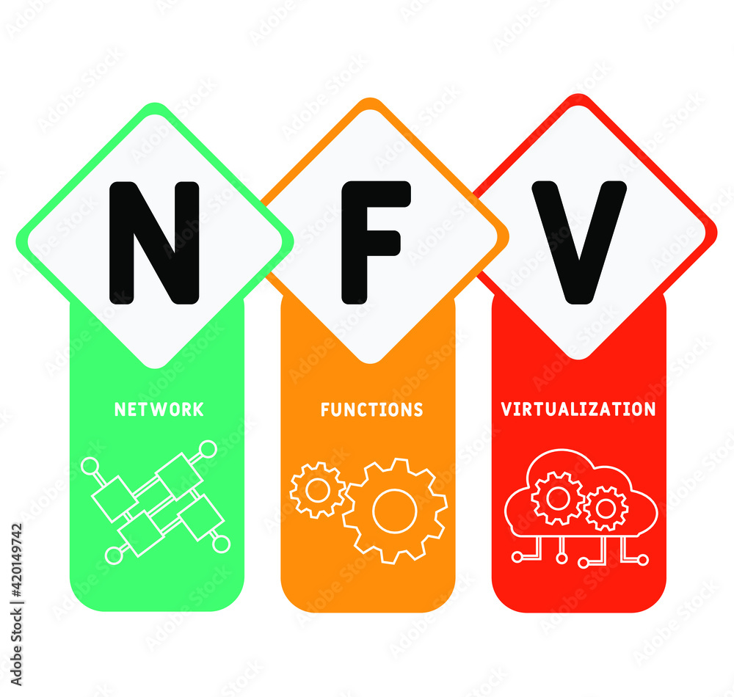
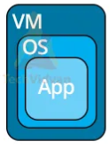
PDS
Computer Vision
Chapter 2:
Architecture Classification
ML, DL
https://github.com/siagianp
https://github.com/amelcharolinesgn2/IoT_simulator-mqtt-NodeRed
https://www.youtube.com/@AmelOline/videos
Notes:
https://medium.com/buildpiper/simplifying-containerization-with-docker-run-command-2f74e114f42a
https://github.com/IBA-Group-IT/IoT-data-simulator
https://www.bevywise.com/blog/docker-mqtt-broker-easy-service-manageability/

Slide 2
Architecture
ML
Convensional
DL
Architecture and Evaluate
Feature Extraction

Slide 3
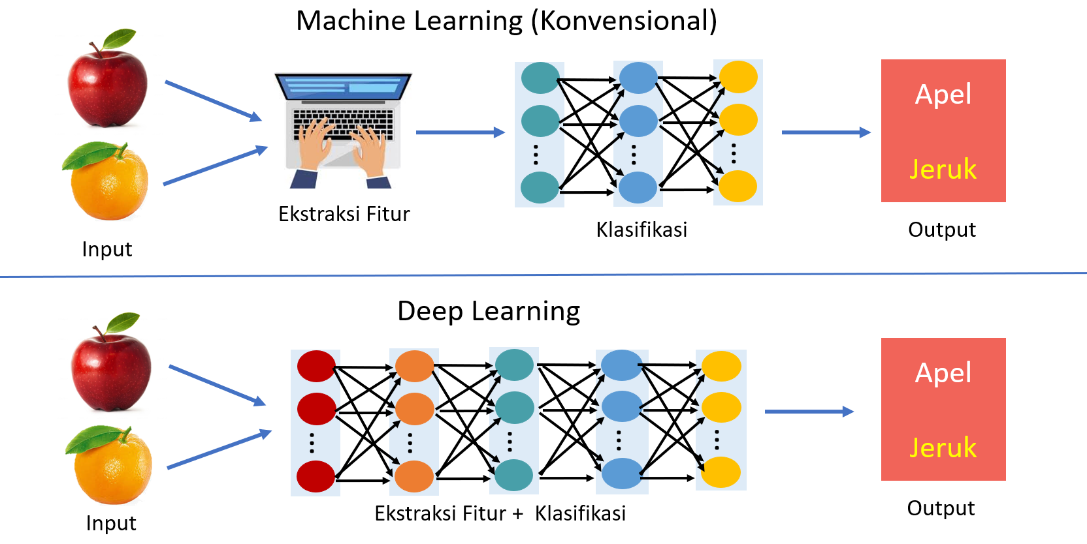

Slide 4
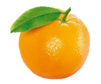
Conventional classification
The conventional classification approach generally performs feature extraction separately and then continues the learning process using conventional classification methods such as Decision Tree, SVM, or ANN.
Praproses
Ekstraksi Fitur
Klasifikasi
Jeruk

Slide 5
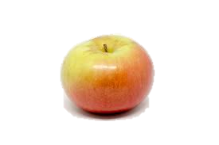
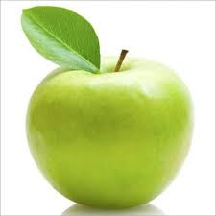
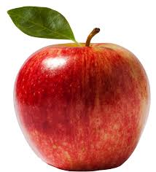
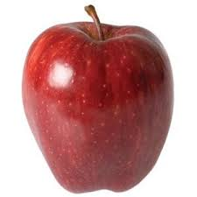
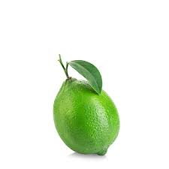
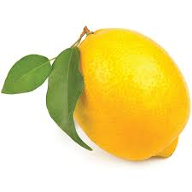
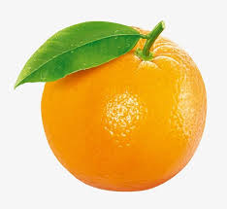
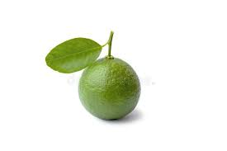
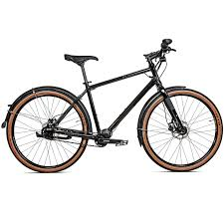

Conventional classification
Ekstraksi Fitur
Klasifikasi
Warna
Bentuk
Tekstur
Warna
Bentuk
Tekstur
Ukuran
Apel
…
Jeruk
Kelemahan
Memerlukan waktu dan pengetahuan lebih untuk ekstraksi fitur
Sangat tergantung pada satu domain permasalahan saja sehingga tidak berlaku general
No | Warna | Bentuk | Tekstur | Kelas
1 | Merah | Bulat | Halus | Apel
2 | Hijau | Bulat | Halus | Apel
3 | Kuning | Lonjong | Kasar | Jeruk
…
N | Hijau | Lonjong | Kasar | Jeruk
No | Warna | Bentuk | Tekstur | Ukuran | Kelas
1 | Merah | Bulat | Halus | Besar | Apel
2 | Hijau | Bulat | Halus | Sedang | Apel
3 | Kuning | Lonjong | Kasar | Besar | Jeruk
…
N-1 | Hjiau | Lonjong | Kasar | Sedang | Jeruk
N | Hijau | Bulat | Halus | Kecil | Jeruk

Slide 6
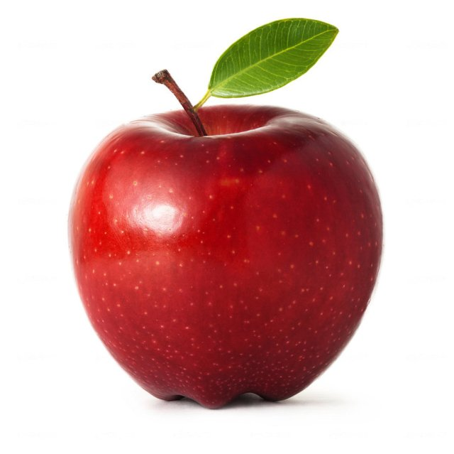
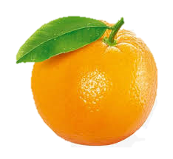
Deep learning classification
Deep learning-based object recognition learns hierarchical representations (feature patterns) automatically through several stages of the feature learning process
Apel
Jeruk
…
…
…
…
…
Ekstraksi Fitur + Klasifikasi
Output
Input
Feature learning
Low-level feature
Mid-level feature
High-level feature
Notes:
Pengenalan obyek berbasis Deep learning mempelajari representasi hirarki (pola fitur) secara otomatis melalui beberapa tahapan proses feature learning

Slide 7
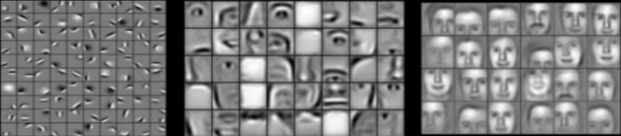
Deep learning classification
The hierarchy in the feature representation shows the increasing level of abstraction.
Each stage is a feature learning process in feature transformation
Kenaikan level abstraksi
Low-level feature
Mid-level feature
High-level feature

Slide 8
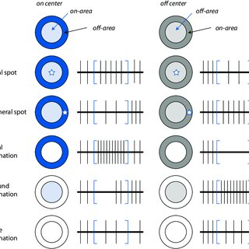
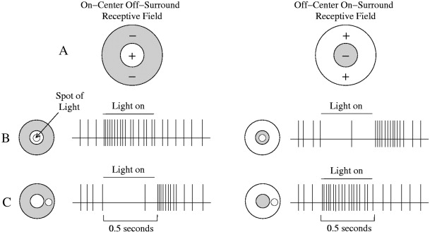
Deep learning classification
Notes:
Seirama dengan penelitian huble, mencari respon otak kucing terhadap pergerakan.

Slide 9
Deep Neural network
Layer 1
Layer 2
Layer 3
Layer 4
Layer L
Output
…….
y₁
…….
y₂
……
……
……
……
……
……
……
….…
y_{M}
Input Layer
Output Layer
Hidden Layers

Slide 10
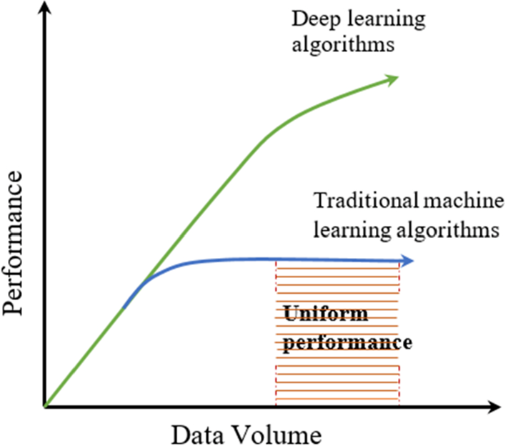
Why Deep Neural network
Notes:
Banyak varian data bisa dihandle dengan baik,

Slide 11
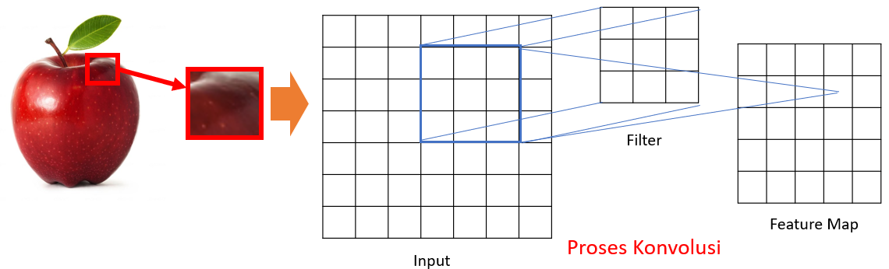
Convolutional Neural Network
CNN merupakan salah satu varian Neural Network dengan beberapa layer konvolusi dan layer lainnya.
Layer konvolusi mempunyai sejumlah filter yang mengaplikasikan operasi konvolusi.

Slide 12
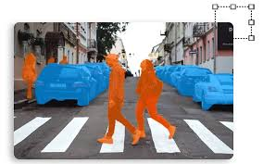
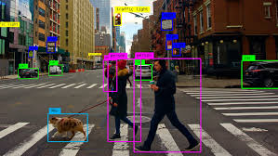
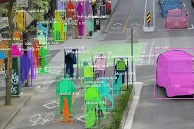
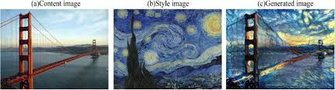
Convolutional Neural Network applications
Object Detection
Image Segmentation
Transfer style

Slide 13
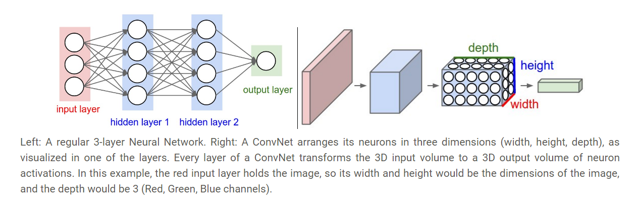
Dense neural network and Convolutional neural network

Slide 14
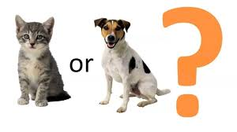
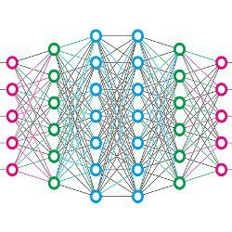
A simple CNN structure
Convolution
motor
mobil
Max Pooling
Dapat dilakukan proses ini secara berulang
Convolution
Fully connected layer
Max Pooling
Flatten

Slide 15
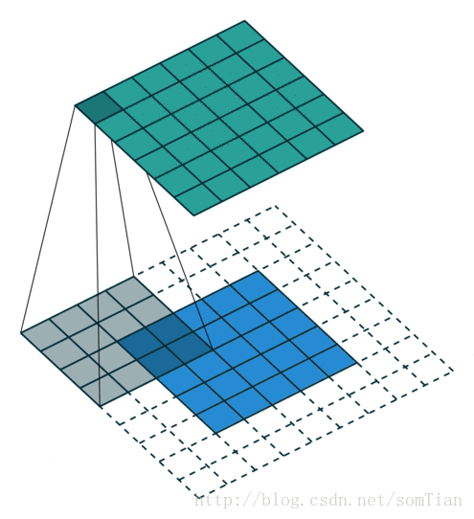

CONVOLUTIONAL KERNEL
$$\left(I∗K\right)\left(i,j\right)=\sum_{m}{\sum_{n}{I\left(m,n\right)K\left(i+m,j+n\right)}}$$
1 | 0 | 0 | 0 | 0 | 1
0 | 1 | 0 | 0 | 1 | 0
0 | 0 | 1 | 1 | 0 | 0
1 | 0 | 0 | 0 | 1 | 0
0 | 1 | 0 | 0 | 1 | 0
0 | 0 | 1 | 0 | 1 | 0
1 | -1 | -1
-1 | 1 | -1
-1 | -1 | 1
*
K
I

Slide 16
Convolutional process
Image
Convoluted Feature (Activation Map)
30 | 30 | 30 | 0 | 0 | 0
30 | 30 | 30 | 0 | 0 | 0
30 | 30 | 30 | 0 | 0 | 0
30 | 30 | 30 | 0 | 0 | 0
30 | 30 | 30 | 0 | 0 | 0
30 | 30 | 30 | 0 | 0 | 0
Filter
0 | 30 | 30 | 0
0 | 30 | 30 | 0
0 | 30 | 30 | 0
0 | 30 | 30 | 0
1 | 0 | -1
1 | 0 | -1
1 | 0 | -1
*
=

Slide 17
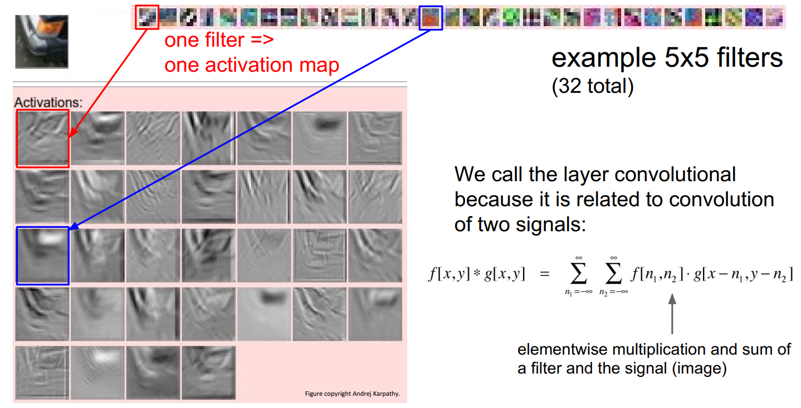
CONVOLUTIONAL PROCESS

Slide 18
CONVOLUTED FEATURE SIZe
The size of the output image resulting from the convolution process can be calculated using the following formula:
Example:
((N - F)/s) + 1 stride =1 ➔ ((5-3)/1) + 1 = 3
N: input size stride= 2 ➔ ((5-3)/2) + 1 = 2
F: filter size
s: stride
Stride adalah besarnya step yang digunakan ketika melakukan sliding filter

Slide 19
Convolution process
Parameters:
Input: 6
Filter Kernel:3
Stride:1
1 | -1 | -1
-1 | 1 | -1
-1 | -1 | 1
1 | 0 | 0 | 0 | 0 | 1
0 | 1 | 0 | 0 | 1 | 0
0 | 0 | 1 | 1 | 0 | 0
1 | 0 | 0 | 0 | 1 | 0
0 | 1 | 0 | 0 | 1 | 0
0 | 0 | 1 | 0 | 1 | 0
Filter 1
-1 | 1 | -1
-1 | 1 | -1
-1 | 1 | -1
Filter 2
……
Citra 6 x 6

Slide 20
Convolution process
stride=1
Parameters:
Input: 6
Filter Kernel:3
Stride:1
1 | 0 | 0 | 0 | 0 | 1
0 | 1 | 0 | 0 | 1 | 0
0 | 0 | 1 | 1 | 0 | 0
1 | 0 | 0 | 0 | 1 | 0
0 | 1 | 0 | 0 | 1 | 0
0 | 0 | 1 | 0 | 1 | 0
3
-1
-3
-1
-3
1
0
-3
1 | -1 | -1
-1 | 1 | -1
-1 | -1 | 1
-3
-3
0
1
Image 6 x 6
3
-2
-2
-1
Filter 1

Slide 21
Convolution process
Parameters:
Input: 6
Filter Kernel:3
Stride:1
1 | 0 | 0 | 0 | 0 | 1
0 | 1 | 0 | 0 | 1 | 0
0 | 0 | 1 | 1 | 0 | 0
1 | 0 | 0 | 0 | 1 | 0
0 | 1 | 0 | 0 | 1 | 0
0 | 0 | 1 | 0 | 1 | 0
3
-1
-3
-1
-1
-1
-1
-1
-3
1
0
-3
-1
-1
-2
1
Feature
Map
-3
-3
0
1
-1 | 1 | -1
-1 | 1 | -1
-1 | 1 | -1
-1
-1
-2
1
3
-2
-2
-1
-1
0
-4
3
Image 6 x 6
Filter 2
Two images 4 x 4
create 2 feature map

Slide 22
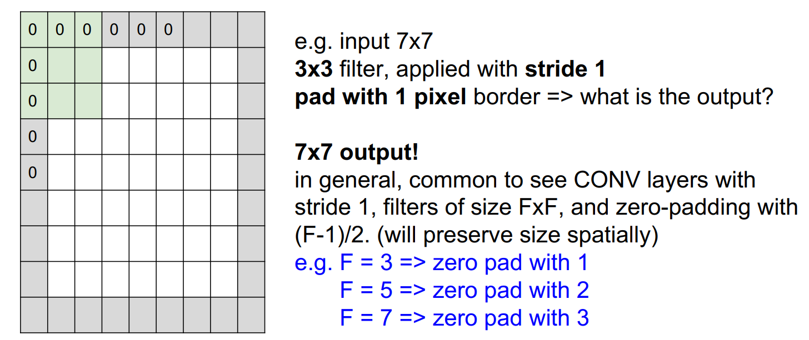
Convolution process : zero padding

Slide 23
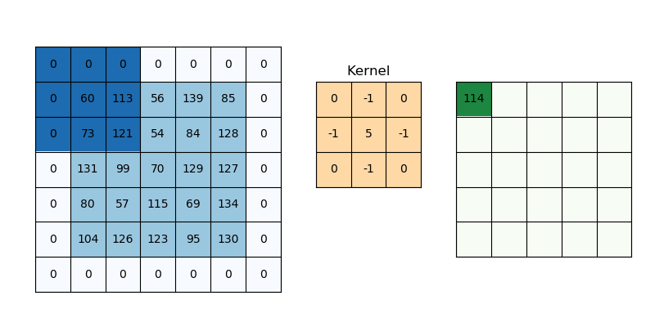
Convolution process : zero padding

Slide 24
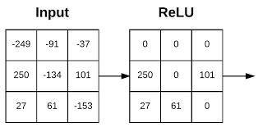
Rectified Linear function
The rectified linear activation function or ReLU for short is a piecewise linear function that will output the input directly if it is positive, otherwise, it will output zero.
Fast computing
Infinite sigmoid
Handles vanishing gradients
$$a$$
f
$$a=x$$
$$a=0$$
$$x$$

Slide 25
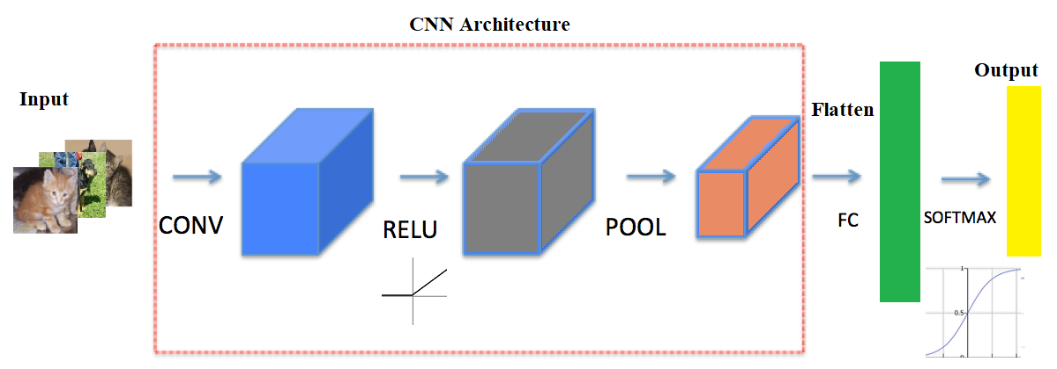

Rectified Linear function
The rectified linear activation function or ReLU for short is a piecewise linear function that will output the input directly if it is positive, otherwise, it will output zero.
Fast computing
Infinite sigmoid
Handles vanishing gradients

Slide 26
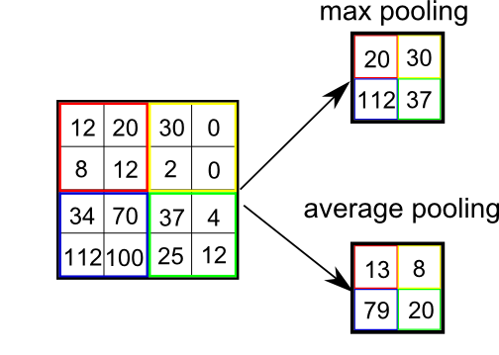
Pooling layer
Pooling layer is used to reduce image size to be smaller (downsample) and extract salient features.
Two types:
Max Pooling
Average Pooling
Notes:
Purpose: find the most significant value to be used as a feature

Slide 27
Pooling layer
Max Pooling
Filter: 2x2
Stride:2
Feature Map
3
-1
-3
-1
-1
-1
-1
-1
-3
1
0
-3
-1
-1
-2
1
-3
-3
0
1
-1
-1
-2
1
3
-2
-2
-1
-1
0
-4
3

Slide 28

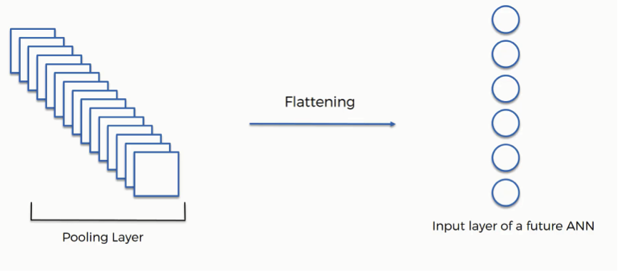
Fully connected layer
A fully connected layer refers to a neural network in which each neuron applies a linear transformation to the input vector through a weights matrix.
As a result, all possible connections layer-to-layer are present, meaning every input of the input vector influences every output of the output vector.
Flat
ten
Fully Connected Network
Output
https://cs.stanford.edu/people/karpathy/convnetjs/demo/cifar10.html
https://medium.com/@muhammadshoaibali/flattening-cnn-layers-for-neural-network-694a232eda6a

Slide 29
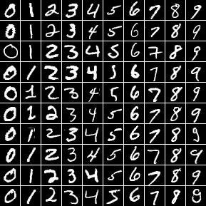
MNIST dataset
The MNIST database of handwritten digits, available from this page:
55,000 training data
10,000 test data
5,000 validation data
It is a subset of a larger set available from NIST.
The digits have been size-normalized (28x28) and centered in a fixed-size image.

Slide 30
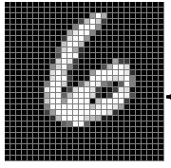


LeNet-5 for MNIST
→ 6
More : https://www.youtube.com/watch?v=pj9-rr1wDhM&t=41s
Notes:
Tambahkan padding agar ukuran input menjadi 32x32

Slide 31
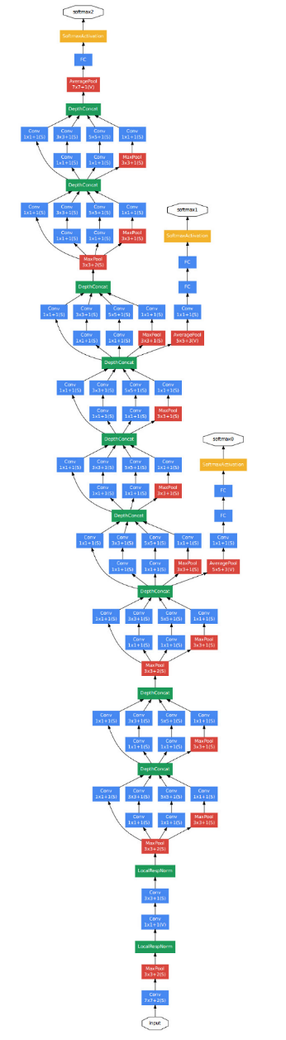
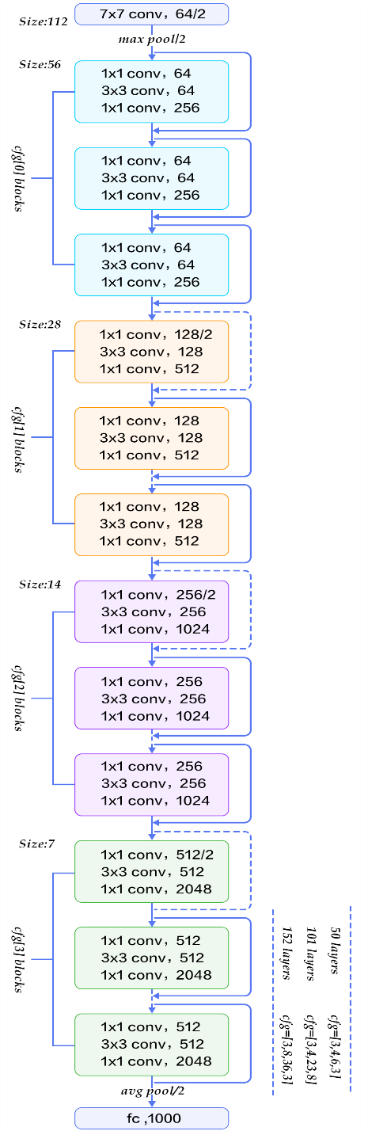
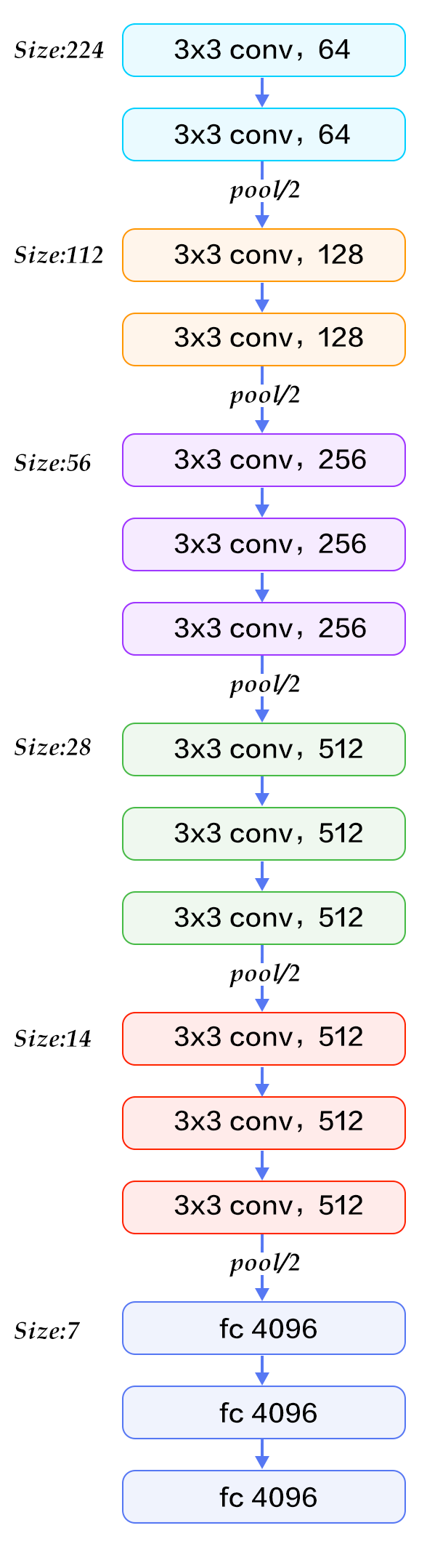
CNN Architectures
VGG-16
GoogleNet
ResNet

Slide 32
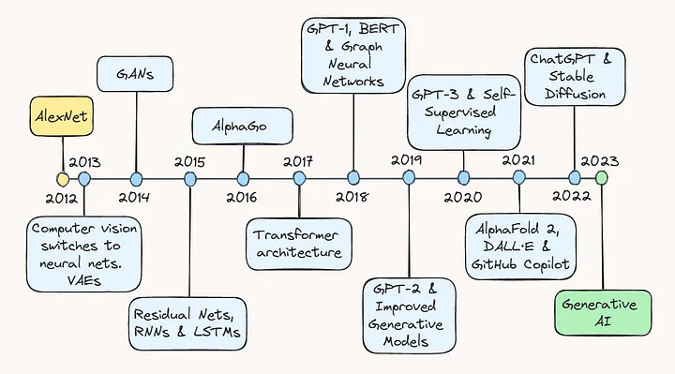
CNN Architecture over a timeline

Slide 33
Thank you!
PDS
SDN
NFV
Computer Vision
Thank you For being a great class!
https://github.com/siagianp
https://github.com/amelcharolinesgn2/IoT_simulator-mqtt-NodeRed
https://www.youtube.com/@AmelOline/videos
Notes:
https://medium.com/buildpiper/simplifying-containerization-with-docker-run-command-2f74e114f42a
https://github.com/IBA-Group-IT/IoT-data-simulator
https://www.bevywise.com/blog/docker-mqtt-broker-easy-service-manageability/

